Slide 1
Welcome!

Slide 2
Everything’s going to be OK.
This is the 7th year we’ve run this course (!!)
You’re in experienced hands.
(I won’t say “good”, necessarily. But experienced.)

Slide 3
Everything’s going to be OK.
Number of emergency room trips: 1
Let’s avoid incrementing that number…

Slide 4
Introducing matt
asst professor in Genome enabled biology. University of New hampshire.
Background: evolutionary biology, genomics, bioinformatics, Mammalogy, Renal physiology, Nursing (hope this won’t come in handy).

Slide 5
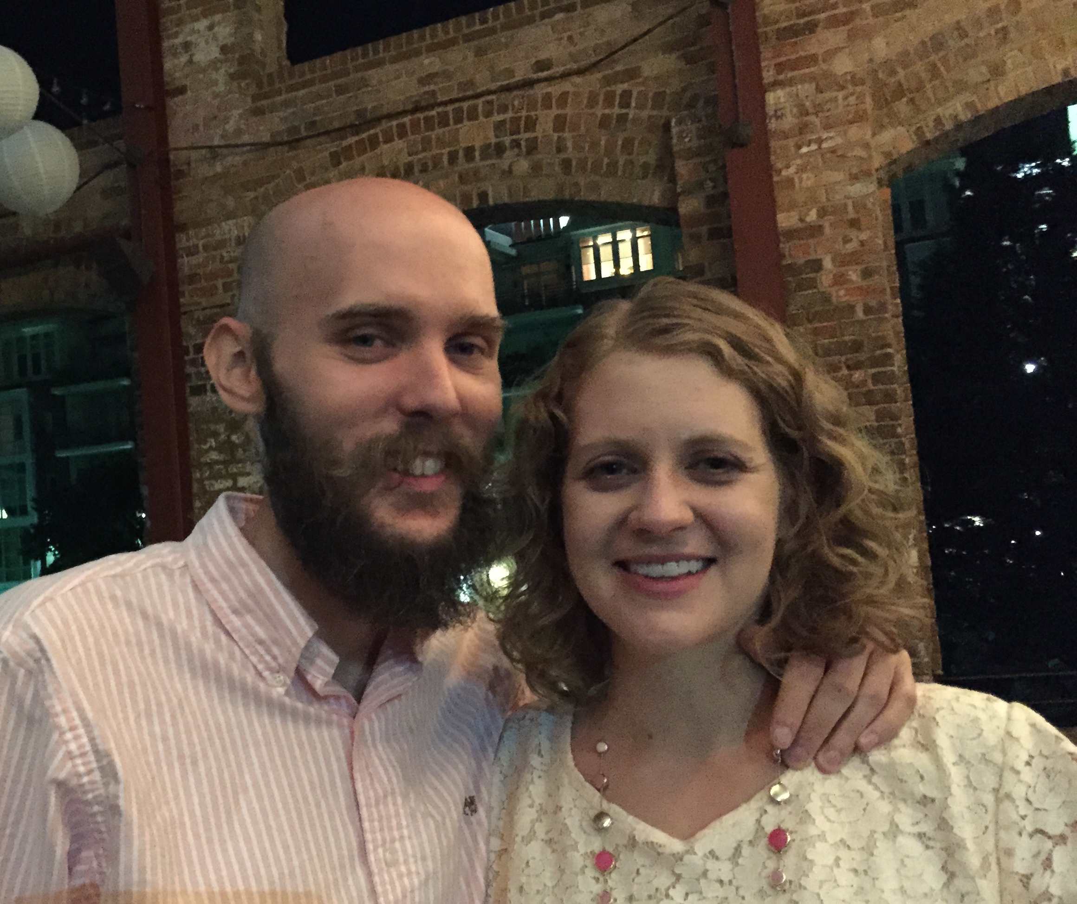
Introducing meg
Assistant professor at university of Tennessee, Knoxville in agricultural bioinformatics
Hardwood tree genomics, genome community database construction (hardwoodgenomics.org), plant stress physiology

Slide 6
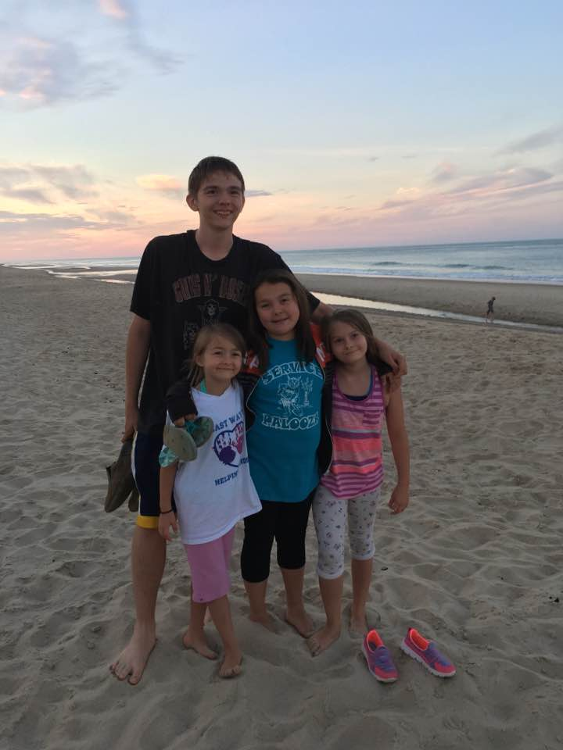
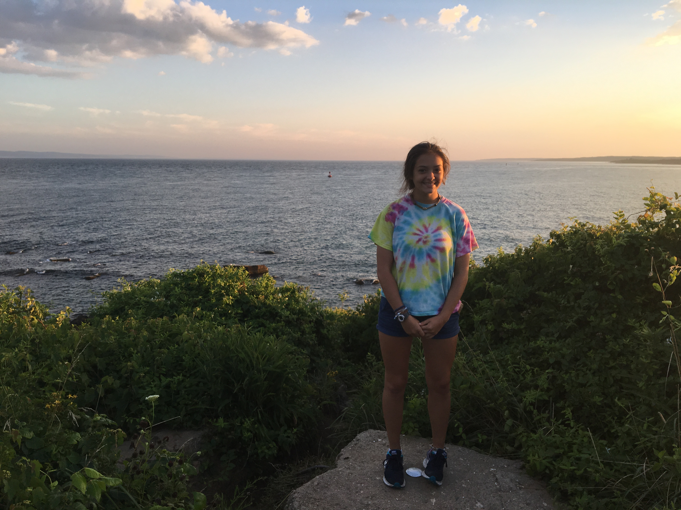
Family!

Slide 7
Others in the room:
Torsten seeman (AUS)
Amanda Charbonneau (MSU)
Lisa Cohen (UC Davis)
Ming (??)
Kate MacManes (UNH)

Slide 8
What are the goals of this workshop?
Expose you all to a bunch of approaches and ideas and details.
Expose you to a particular way of thinking.
Train you in a particular way of learning and doing.
Networking!
At the worst, you will find out you know more (or less) than you thought.

Slide 9
Our approach.
Provide a safe & welcoming place to experiment.
Lots and lots of help (in the form of Ta’s)
Provide lots of data sets, tools, scripts.
Research specific help as possible.

Slide 10
Daily schedule (generally)
745-845: breakfast
9:15am – lecture
10:30am – tutorial 1
12-1pm - lunch
1:15pm – tutorial 2
3pm – free time!
6-7- dinner (unless noted otherwise)
7pm – tutorial/lecture and/or fun

Slide 11
Workshop materials
All the workshop materials will be openly available forever!
(Or at least indefinitely.)
You can download them and cherish them forever (I’m happy to show you how).
They may not be up to date until ~the lecture/tutorial, though.

Slide 12
Something that we don’t talk about enough in this workshop:
Most / best bioinformatics information is online:
Blogs
Twitter
SeqAnswers
Biostars
Spend some time poking around while you’re here. We have some suggestions on the course web site.

Slide 13
Written rules
No night-swimming without a buddy.
I mean it.

Slide 14
Code of Conduct
http://angus.readthedocs.org/en/2016/code-of-conduct.html
tl;dr? Don’t be a jerk.
I will post Judi Brown Clark’s contact information on the wall shortly.
Note: this is not because of known prior problems.

Slide 15
Food and drink
Anything group-intended can be purchased by Katie. Please post it to Slack #shopping.
Katie can also drive you to the market/bank/other place; She’ll probably go every two or three days.
Please don’t ask katie to spot you $$.

Slide 16
Games and location.
We have volleyball, frisbee, frisbee golf, boche balL, Foosball
Also cards. Other board games needed?
There are good places to run, to swim, to hike, to bike, and to fish.
We also have laundry and weight room (?)

Slide 17
Free time, more generally.
Please be sure to take time off as you need it.
Not only is relaxation important, given the next two weeks, but the networking is also important.
Plus, the TAs and profs need the time off too :>

Slide 18
Unwritten rules

Slide 19
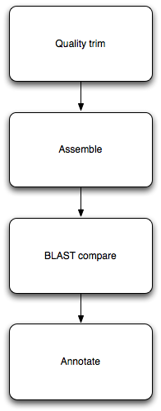
How does this stuff work?
Typically, you need to run multiple different programs in sequence.
Each program takes in data, in files; and outputs data, in files.
(Some programs also produce pretty pictures via the Web.)
Notes:
Ipython notebook

Slide 20
Automation & computational efficiency matter
You’ll learn to run lots of different programs here.
We’ll run into some practical problems:
Some programs take a long time to run.
Some programs take many different parameters; which are best?
Some programs don’t finish on “cheap” hardware.
How do we run many long-running programs? How do we remember what we did? How do we get our programs to finish?

Slide 21
“Heuristics”
What do computers do when the answer is either really, really hard to compute exactly, or actually impossible?
They approximate! Or guess!
The term “heuristic” refers to a guess, or shortcut procedure, that usually returns a pretty good answer.

Slide 22
Heuristics come up a lot.
Mapping.
Assembly.
Statistics (Monte Carlo and resampling methods).
Simulations.
More generally, most “interesting” algorithms involve approximations and shortcuts. When are they (in)appropriate for your task?

Slide 23
Experimental Bioinformatics
What is the best mapper/assembler/read trimmer/…
What parameters should I use
How much data do I need
Bigger computer == Faster results?

Slide 24
I’ll literally die if I don’t learn this within 2 weeks…

Slide 25
Concluding thoughts
There’s what you can do today, computationally, with existing programs. This is often limited by our time, experience, etc.
There’s what you could, in theory, do with the data you had. This is the upper limit on your accuracy.
Figuring out the difference is one of the main reasons you’re here :)

Slide 26
Process and materials!
Slack
Twitter: #ngs2016; I’m @macmanes
Facebook group??

Slide 27
Use the stickies, Luke…

Slide 28
Any questions or comments?

